Slide 1
Do fans know who the best NBA players are?
By Noel Mathew

Slide 2
Problem to Answer
The NBA is a star-driven league where fans gravitate to certain high performing players.
Those players usually generate a lot of buzz on social media platforms like Twitter, and people will buy tickets just to watch that player play, etc.
How much a players’ performance factor into if a player is considered a star

Slide 3
Who is my client
NBA Teams
If they have high performing player then can promote him to increase attendance numbers
Agents
High Performing Players who do not generate buzz
NBA itself
Can promote new players to generate buzz for the league
This will help the first two clients as well

Slide 4
Data that will be used
Basketball statistics from the 2017 season
Basic stats: points, rebounds, assists, blocks, etc.
Advanced stats: RPM, Win Share, Player efficiency, etc.
Online presence during the 2017 season
Wikipedia page views
Twitter retweets/favorites
Data set that will be used
https://www.kaggle.com/noahgift/social-power-nba.

Slide 5
Data Cleaning Steps
Combined the basic stats and advanced stats to one data frame
Basic Stats: Points, Rebounds Assists, Steals, Blocks
Advances Stats: RPM, Net Rating, Win share, Player Efficiency.
Combined online presence/buzz to one data frame
Wikipedia page views
Twitter Retweets/Favorites
Team Attendance stats (AVG/PCT)
Combined the results from above to a final data frame

Slide 6
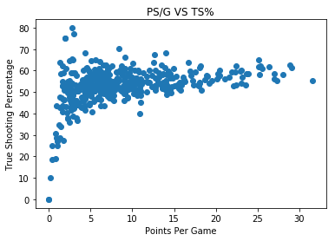
Data Story: Relationship between stats

Slide 7
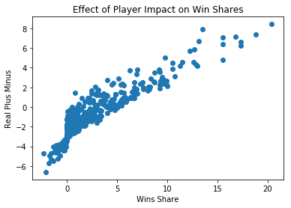

Slide 8
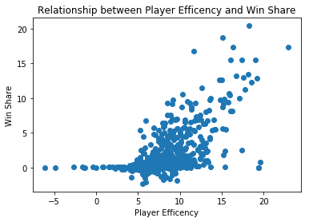

Slide 9
Summary of the Graphs
Here are examples to check correlation among stats
Points per game is the stat the fans notice the most, so check this stat relationship with other stats
There seems like there is a positive logistic relationship between PS/G and TS%
More points scored leads to a higher true shooting percentage
Players Win Share – players who leads their teams to wins are the usually the popular ones
Players who have high win share have high positive impact on the floor
This looks like a positive linear relationship
Players who are most efficient usually leads to higher win share
The relationship looks like exponential graph

Slide 10
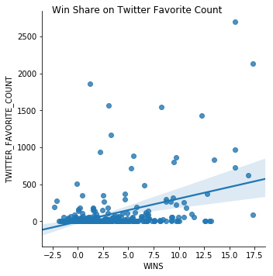
Data Story: Relationship between Stats and Presence

Slide 11
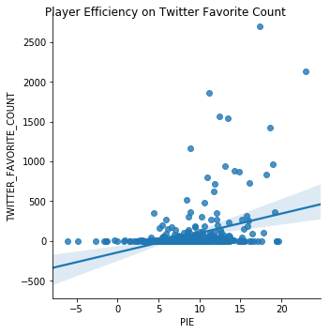

Slide 12
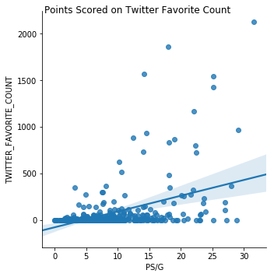

Slide 13
Summary of Graphs
This shows the relationship between Twitter Favorite Count and players stats
It seems like for a lot of players that no matter how they perform their social media presence is small
However there is a positive correlation between a player’s performance and their social media presence
Win Share, Players’ Efficiency , and PS/G are stats used because they are easy stats to understand

Slide 14
Model Prediction
Utilize A K Nearest Neighbors Model to predict how a players’ performance impact their social media performance
Using this model because comparing players to each other is the best way to know if a player's social media presence matches up to their performance

Slide 15
Making the model
First combined Twitter Favorites and Twitter Retweets into one value to use as the test label
Second combined the basic stats like PS/G, TRB, AST, STL, BLKS to make position/ball usage non-factor
Third drop team related values like W, L, the basic stats, and social media stats.
Used KNN to fit the training feature and label set and predict the test feature and label set
Ran the KNN on the data set on the whole for each player to find the three nearest neighbors
Used Mean Square Error to score the model performance
362.08181078192126 is the MSE

Slide 16
Recommendations
Used the model to find the most unnoticed player in the league based on performance
That player is Rudy Gobert
He had the largest difference between the predicted value and actual value of social media score
Found the three nearest neighbors for him
DeAndre Jordan
Steph Curry
Markieff Morris
Based on the information Rudy Gobert should be marketed more as his performance is comparable to more popular players like DeAndre Jordan and Steph Curry

Slide 17
Recommendations Part 2
The NBA should help promote Rudy Gobert so at least near the social media presence of DeAndre Jordan
His Agent should see what DeAndre Jordan appealing to fans an apply that to Gobert

Slide 18
Improvements and Further Learning
If there is a model with a better score, that model will be used
Use stats/data for multiple years to get a more consistent performance and social media presence
Find information on the player’s team market size
Find information on how often the player is talked in the media
Find player engagement on social media
Separate superstars and role players

